Slide 1



AMPWISE · EV CHARGING ACTION ENGINE
1 charger.
Over 1 month.
Notes:
0:00-0:30. Pause two seconds after "Over 1 month." Operators are not careless; they just cannot see which fault costs the most.

Slide 2
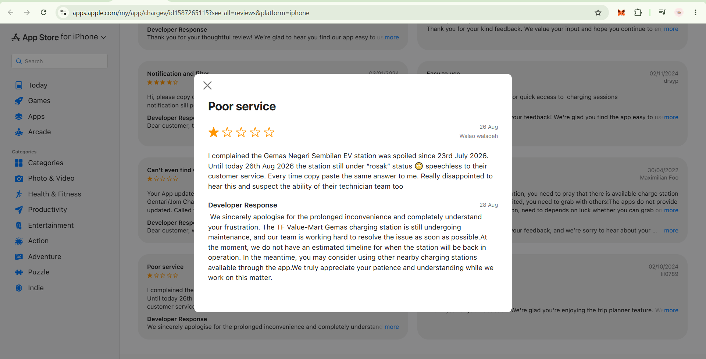

Slide 3
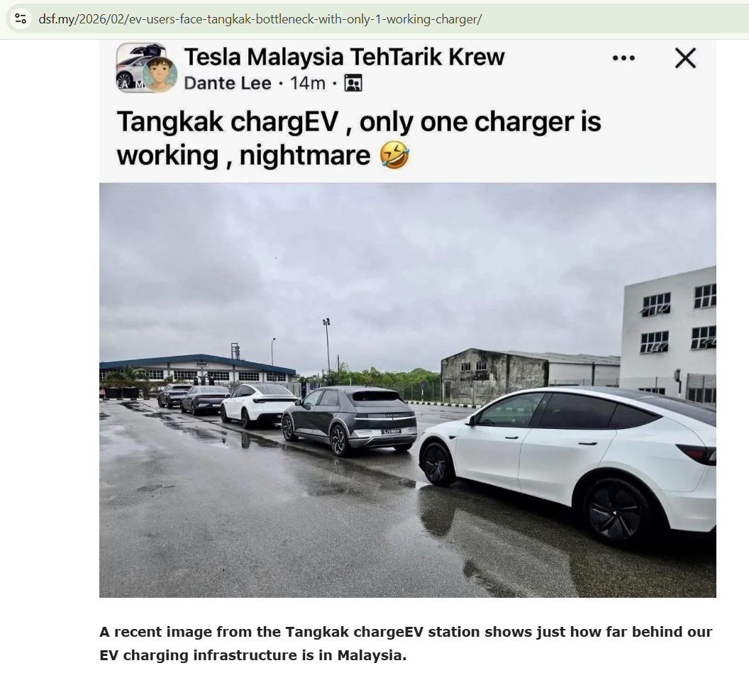

Slide 4
AMPWISE
EV CHARGING ACTION ENGINE
Notes:
0:00-0:30. Pause two seconds after "Over 1 month." Operators are not careless; they just cannot see which fault costs the most.

Slide 5
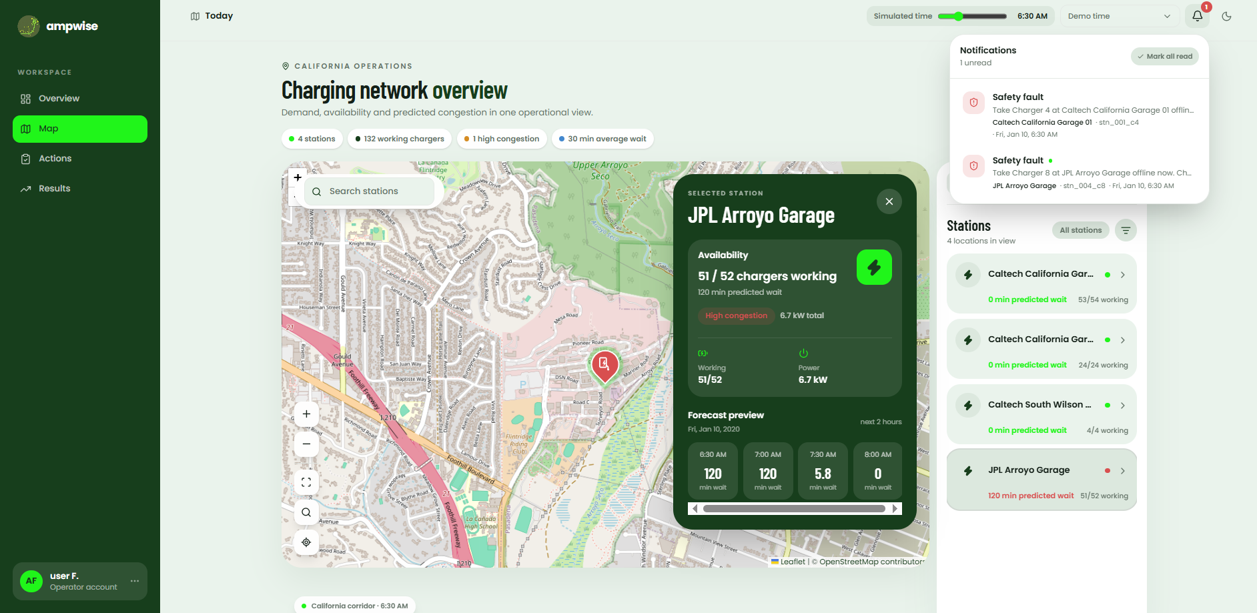
Time slider
Notifications
Stations and congestion
Notes:
0:30-0:45. Three steps: forecast, impact, action.

Slide 6




Same broken charger. Two stations.
Quiet station
Busy station, Friday evening
Few drivers affected
Many drivers turned away
Action: schedule this week
Action: send a technician today
Illustrative example of how the same fault ranks differently.
Notes:
Key memorable moment. Say: same broken charger, two stations, different priority. Then show it live on the Actions page.

Slide 7
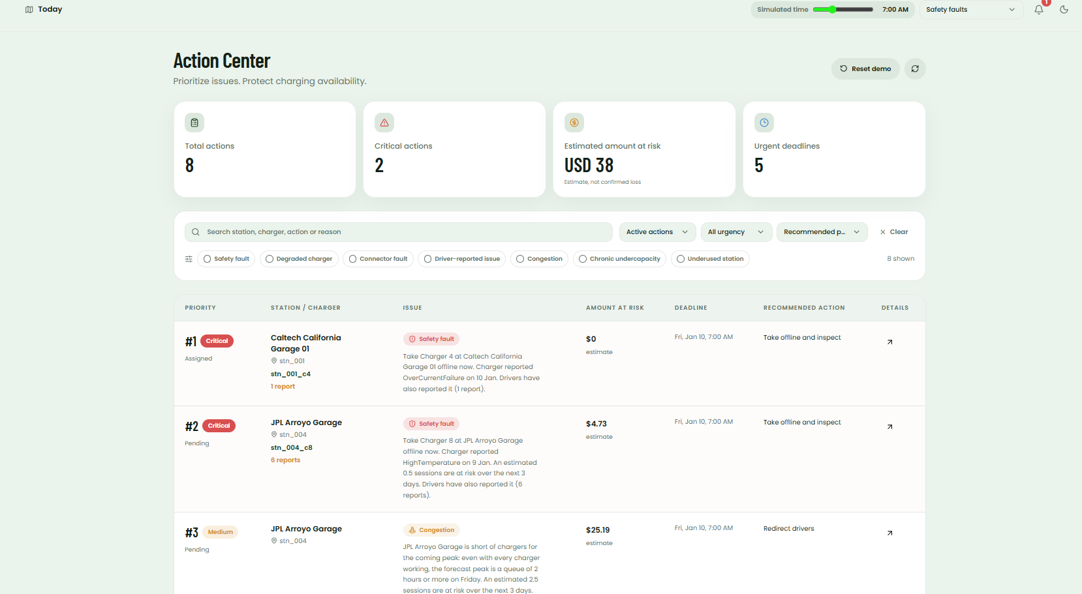
Notes:
0:30-0:45. Three steps: forecast, impact, action.

Slide 8



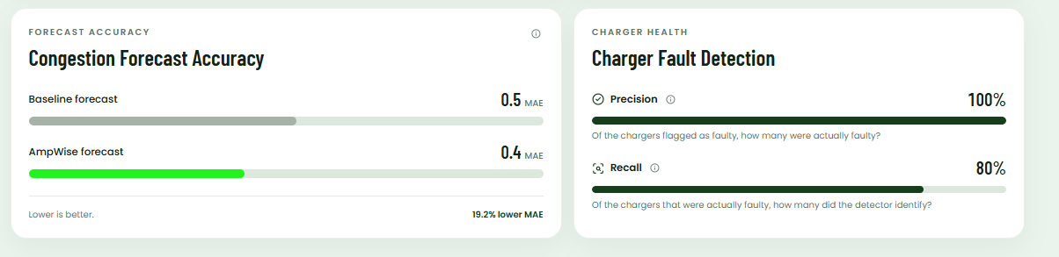
Does it work? One test week against the traditional baseline
3 · RESULTS
19.2%
80%
412 min
lower forecast error than the baseline
of real faults found, with 100% precision, on 1056 simulated faults
estimated queue time avoided
Notes:
2:20-2:45. Switch to the live Results page. State how many faults [N] sit behind precision and recall, and say the fault data is simulated.

Slide 9
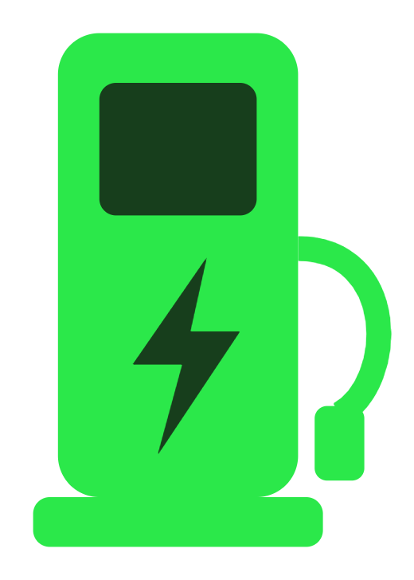

Fix the right thing first
AmpWise
Notes:
2:45-3:00. Callback to Gemas, then end on: same broken charger, two stations, different priority.

